Slide 1
Government Intervention in Markets
Chathuranga Adhikari
B.com (Sp)(Hons), M.com

Slide 2
Upon the successful completion of this lecture, you’ll be able to,
Understand Market equilibrium and disequilibria
Describe types of Government Intervention
Describe types of Goods, Buffer Stocks Income Guarantee Schemes and Price Controls
Explain Market failures

Slide 3
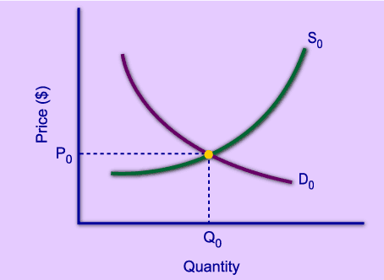
Market Equilibrium
The operation of the market depends on the interaction between buyers and sellers.
An equilibrium is a condition that exists when the quantity supplied and quantity demanded are equal.
At equilibrium, there is no tendency for the market price to change.

Slide 4
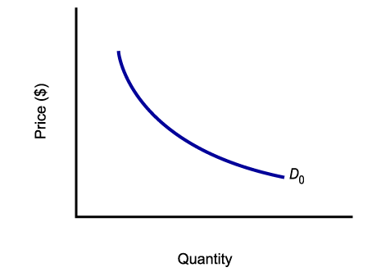
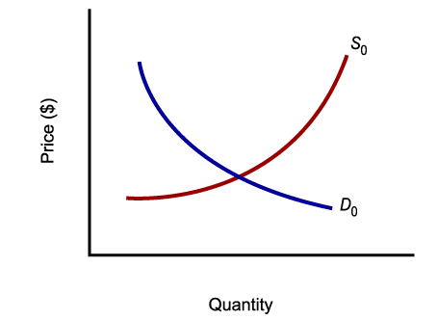
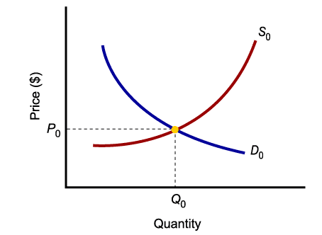
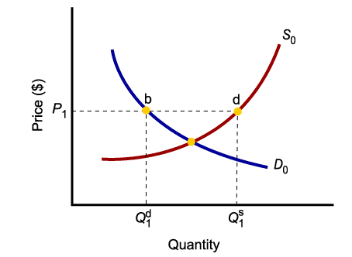
Market Equilibrium
Only in equilibrium is the quantity supplied equal to the quantity demanded.
At any price level other than P₀, the wishes of buyers and sellers do not coincide.

Slide 5
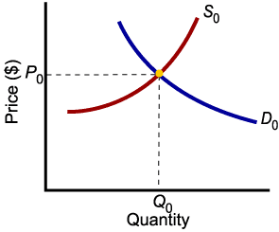
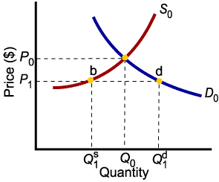
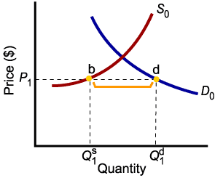
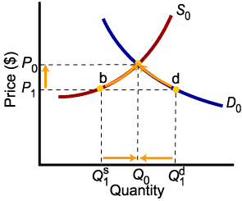
Market Disequilibria
Excess demand, or shortage, is the condition that exists when the quantity demanded exceeds the quantity supplied at the current price.
When the quantity demanded exceeds the quantity supplied, the price tends to rise until equilibrium is restored.

Slide 6
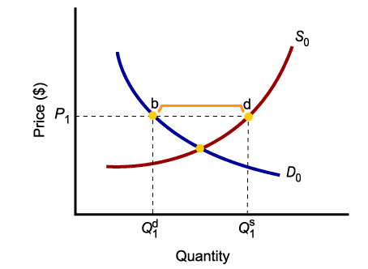
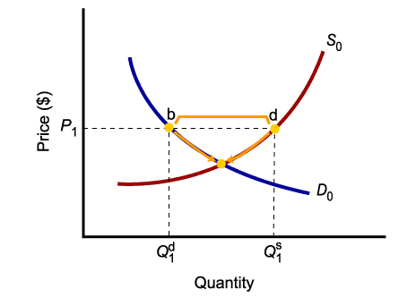
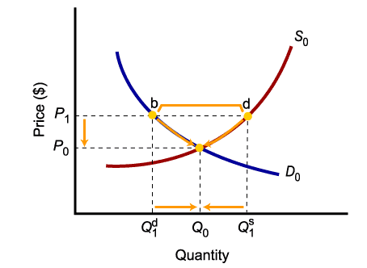
Market Disequilibria
Excess supply, or surplus, is the condition that exists when the quantity supplied exceeds the quantity demanded at the current price.
When the quantity supplied exceeds the quantity demanded, the price tends to fall until equilibrium is restored.

Slide 7
Methods of Government Intervention
Buffer Stocks
Price Controllings (Maximum price and Minimum Price)
Taxations
Subsidies
State provision
Regulation

Slide 8
Government Intervention in Markets
Buffer Stocks
A buffer stock is a system;
  -buys and stores stocks at times of good harvests to prevent prices from falling below a price level
  -releases stocks during bad harvests to prevent prices from rising above a price level
Influencing market supply through holding or releasing stocks to stabilize prices or incomes
Short term measure
Used in agriculture where supply can be volatile
Assumption: supply is perfectly inelastic in the short run
Only useful where goods can be stored

Slide 9
Government Intervention in Markets
S (Bad harvest)
S (Good Harvest)
Buffer Stock
to stabilise price:
Price
Target Price
TP
After a good harvest the government ‘buys up’ 60 units and puts it into store
After a bad harvest, government releases 50 onto market
Government sets a target price (TP)
D
50
100
160
Quantity Bought and Sold

Slide 10
Government Intervention in Markets
Income stabilization Schemes:
Buffer stocks do not guard against volatile incomes
Aim to ensure farm incomes remain relatively constant – manipulate price through releasing stocks or adding to stores

Slide 11
Government Intervention in Markets
Problems of such schemes:
  Farmers do not respond to market signals – the market becomes distorted
  Overproduction if incomes guaranteed
  Issues in storing food
  Cost of storage
  Farmers’ moral issues – constant income
  Long-term sustainability, international effects – LDCs, World Trade Organisation

Slide 12
02. Price Ceilings
A price ceiling occurs when a government sets a legal limit on the price of a good or service – with the aim of reducing prices below the market equilibrium price. (it is the highest price that can be set by a producer, group of producers or a whole industry).
It’s also called maximum price.
A maximum price might be considered as providing a benefit to consumer. (Protect consumers)
To be effective a maximum price need to be set below the free market price.

Slide 13
Price Ceilings
Price Controls:
Maximum Prices
below normal equilibrium
Price
S
Black Market
Price
£18
Suppliers reduce the amount offered to 60 but demand would rise to 140 creating a shortage of 80 – rationing might have to be introduced
Shortages may lead to black market prices way above the equilibrium free market level
The government imposes a maximum price of £6 (P Max)
Assume the equilibrium
price is £10 and the
amount bought and sold is 100
£10
£6
P Max
D
60
100
140
Quantity Bought and Sold

Slide 14
Question 01
Qd = 100 – 5P
Qs = 5P
Maximum Price Rs. 8

Slide 15
P
20
S
C/S
A
12
B
E
10
C
F
8
Max/P
D
P/S
D
40
50
60
100
Q

Slide 16
Advantages and Disadvantages of price ceiling
Disadvantages
Shortages
Lack of incentives
Black market
More unemployment
Less choice
Advantages
More affordable price
Price stability
Grater demand

Slide 17
Exercise
The developing country decides to set a maximum price on product “X” to make sure that product “X” is affordable to everyone. The demand, supply, and the maximum price are given below.
Qd = 100-5P
Qs = -20+5P
Maximum Price = Rs. 10

Slide 18
03. Price Floor
The government-imposed price controls that set the lowest legal price at which a good or service can be sold.
It’s also called minimum price.
This price is usually set above the equilibrium price (the point where supply meets demand in a free market).
The goal is often to protect producers from prices that are deemed too low and ensure that they can cover their costs of production, thus earning a reasonable income.

Slide 19
Price Floor
Price Controls:
Minimum Prices set
above normal equilibrium
Price
S
£9
Min P
At the higher price, demand would fall whereas supply would rise – a surplus would exist.
Assume initial
equilibrium price = £5
and amount bought and
sold = 200
Government imposes minimum price of £9 (Min P)
£5
D
170
200
240
Quantity Bought and Sold

Slide 20
Advantages and Disadvantages of Minimum Price
Disadvantages
Inefficient resource allocation
Customers have to spend higher price
Surplus production
Advantages
Protecting producers
Encourage production
Correcting market failure
Reducing consumption

Slide 21
Question 02
Qd = 100 – 5P
Qs = 5P
Minimum Price Rs. 12

Slide 22
P
20
S
C/S
A
12
Min/P
B
L
E
10
K
C
F
J
G
8
D
H
I
P/S
D
40
50
60
100
Q

Slide 23
Exercise
The government decides to set a minimum price on product “Y” to motivate the producers of the product “Y.” The demand, supply, and minimum price are given below.
Qd = 9000-10P
Qs = -1000+10P
Minimum Price = Rs. 700

Slide 24
Consumer and Producer Surplus
When government controls price, some people are better off.
  May be able to buy a good at a lower price
But, what is the effect on society as a whole?
  Is total welfare higher or lower and by how much?
A way to measure gains and losses from government policies is needed.

Slide 25
Consumer and Producer Surplus
Consumer surplus is the total benefit or value that consumers receive beyond what they pay for the good.
  Assume the market price for a good is $5
  Some consumers would be willing to pay more than $5 for the good
  If you were willing to pay $9 for the good and pay $5, you gain $4 in consumer surplus
Notes:
5

Slide 26
Consumer and Producer Surplus
The demand curve shows the willingness to pay for all consumers in the market
Consumer surplus can be measured by the area between the demand curve and the market price
Consumer surplus measures the total net benefit to consumers

Slide 27
Consumer and Producer Surplus
Producer surplus is the total benefit or revenue that producers receive beyond what it cost to produce a good.
  Some producers produce for less than the market price and would still produce at a lower price
  A producer might be willing to accept $3 for the good but get a $5 market price
  Producer gains a surplus of $2

Slide 28
Consumer and Producer Surplus
The supply curve shows the amount that a producer is willing to take for a certain amount of a good
Producer surplus can be measured by the area between the supply curve and the market price
Producer surplus measures the total net benefit to producers

Slide 29
Consumer and Producer Surplus
Price
9
Consumer
Surplus
S
Between 0 and Q₀ consumer A receives a net gain from buying the product-- consumer surplus
5
Producer
Surplus
3
Between 0 and Q₀
producers receive
a net gain from
selling each product--
producer surplus.
D
Q_{D}
Q_{S}
Q₀
Quantity

Slide 30
Consumer and Producer Surplus
To determine the welfare effect of a governmental policy we can measure the gain or loss in consumer and producer surplus.
Welfare Effects
  Gains and losses to producers and consumers.
Notes:
10

Slide 31
Consumer and Producer Surplus
When government institutes a price ceiling, the price of a good can’t to go above that price.
With a binding price ceiling, producers and consumers are affected
How much they are affected can be determined by measuring changes in consumer and producer surplus

Slide 32
Consumer and Producer Surplus
When price is held too low, the quantity demanded increases and quantity supplied decreases
Some consumers are worse off because can no longer buy the good.
  Decrease in consumer surplus
Some consumers better off because can buy it at a lower price.
  Increase in consumer surplus

Slide 33
Consumer and Producer Surplus
Producers sell less at a lower price
Some producers are no longer in the market
Both of these producer groups lose and producer surplus decreases
The economy as a whole is worse off since the surplus that used to belong to producers or consumers are simply gone.

Slide 34
Consumer and Producer Surplus
Price
Consumer Surplus
S
P_{o}
Producer Surplus
D
Q_{o}
Quantity

Slide 35
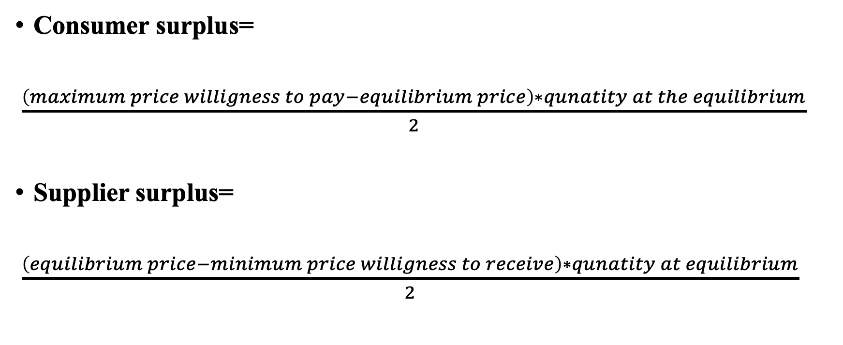
Equations to calculate consumer surplus and producer surplus at the equilibrium
Consumer surplus=
$\frac{\left(maximum price willigness to pay−equilibrium price\right)∗qunatity at the equilibrium}{2}$
Supplier surplus=
$\frac{\left(equilibrium price−minimum price willigness to receive\right)∗qunatity at equilibrium}{2}$

Slide 36
Price Control and Surplus Changes
Price
Consumers that can buy the good gain A
Consumers that cannot buy, lose B
S
The loss to producers is the sum of rectangle A and triangle C.
B
P₀
A
C
Triangles B and C are losses to society – dead weight loss
P_{max}
D
Q₁
Q₀
Q₂
Quantity
Notes:
13

Slide 37
Price controls and Welfare Effects
The total loss is equal to area B + C.
The deadweight loss is the inefficiency of the price controls – the total loss in surplus (consumer plus producer)
Notes:
14

Slide 38
The Efficiency of a Competitive Market
In the evaluation of markets, we often talk about whether it reaches economic efficiency
  Maximization of aggregate consumer and producer surplus
Policies such as price controls that cause dead weight losses in society are said to impose an efficiency cost on the economy
Notes:
30

Slide 39
The Efficiency of a Competitive Market
If efficiency is the goal, then you can argue leaving markets alone is the answer
However, sometimes market failures occur
  Prices fail to provide proper signals to consumers and producers
  Leads to inefficient unregulated competitive market

Slide 40
Types of Market Failures
Externalities
  Costs or benefits that do not show up as part of the market price (e.g. pollution)
  Costs or benefits are external to the market
Public Goods- National Defense
Monopolies
Lack of Information
  Imperfect information prevents consumers from making utility-maximizing decisions.
Government intervention may be desirable in these cases
Notes:
30

Slide 41
The Efficiency of a Competitive Market
Other than market failures, unregulated competitive markets lead to economic efficiency
What if the market is constrained to a price higher than the economically efficient equilibrium price?

Slide 42
Price Control and Surplus Changes
Price
S
P_{min}
A
When price is regulated to be no lower than P_{min}, the deadweight loss given by triangles B and C results.
B
P₀
C
D
Q₁
Q₀
Q₂
Quantity
Notes:
13

Slide 43
The Efficiency of a Competitive Market
Deadweight loss triangles, B and C, give a good estimate of the efficiency cost of policies that force price above or below the market clearing price.
Measuring effects of government price controls on the economy can be estimated by measuring these two triangles

Slide 44

Methods of Government Intervention
Financial intervention: use of taxes and subsidies.
The government uses taxes and subsidies as financial tools to influence the production and price of goods or services in an economy.
Tax: charges imposed by the government on incomes, profits, and some types of consumer goods and services to fund their expenditure.
  E.g. stamp duty, income tax, GST, service tax, etc.
Notes:
Influence – change spending pattern

Slide 45
04. Taxations
Qd = a - bP
Qs = a + bP
Qst = a + b(P-t)

Slide 46
Loss in Efficiency
Taxation
S_{Tax}
Price
Tax
S
New Consumer Surplus
Lost Consumer Surplus
Deadweight Loss
P_{D}
Tax Revenues
P_{o}
Lost Producer Surplus
P_{S}
New Producer Surplus
D
Q_{L}
Q_{o}
Quantity

Slide 47
Question 03
Qd = 200 - 10P
Qs = -100 + 20P
Tax = Rs. 3

Slide 48
P
St
20
C/S
Gov. Tax Revenue
S
12
10
D/W/L
9
P/S
8
5
D
-100
80
100
200
Q

Slide 49
Exercise
Qd = 150 – 10P
Qs = -90 + 10P
Tax = Rs. 2

Slide 50

Methods of Government Intervention
Financial intervention: use of taxes and subsidies.
Subsidies: a direct payment or grants by the government to producers, making the price paid by consumers less than it should be.
  Subsidies goods and services that benefit the community and might not be provided under the free market.
  E.g. certain food, public transport, free school meals for kids from low-income families.

Slide 51
05. Subsidies
Qd = a - bP
Qs = a + bP
Qss = a + b(P+s)

Slide 52
Loss in Efficiency
Subsidy
Price
Gain in Producer Surplus
S
New Consumer Surplus
P_{S}
S_{Sub}
Subsidy
Gain in Consumer Surplus
P_{o}
P_{D}
Deadweight Loss
New Producer Surplus
Subsidy Cost
D
Q_{o}
Q_{H}
Quantity

Slide 53
Question 04
Qd = 100 – 5P
Qs = -20 + 5P
Subsidy = Rs. 4

Slide 54
Exercise
Qd = 70 – 2P
Qs = -10 + 2P
Subsidy = Rs. 2.5

Slide 55
Methods of Government Intervention
06. Government provision / Direct provision
Government to take over the production of goods or services, either in part or in whole.
Supply the goods or services directly to the customer free of charge.
State-owned industries: electricity, water provision, railways.
Also applies to those industries supplied by both public and private sectors: education, and hospitals.

Slide 56
Methods of Government Intervention
07. Regulation
Various means by which the government seeks to control production and consumption.
Rules and laws that apply to firms to control the free market.
Uses legal or other methods such as control of price, quality, and quantity of goods and services that are produced or consumed.
Ex. Doctor’s prescription to buy controlled drugs.

Slide 57

Thank you
Any Questions?

